Slide 1

Transaction Category Prediction using Machine Learning
Machine Learning Online final Project

Slide 2

Purpose Statement
This project is automatically classifying transactions into product categories using
NLP Lite + Unsupervised + Supervised Hybrid Model
By Nardy Attaalla – ReDI School ML Project

Slide 3
Why this Project ?
I chose this project because i wanted to experiance fintech machine learning tasks.
Not enough features to use which I resolved using Clustering, NLP, and Classifications
I chose this idea because it has some challengings and used in several systems and its really important for bank assistance of customer money requests and money management along with feedbacks on spendings.
Revolut uses similar transaction-categorization models to group purchases.and detect unusual spendings
I chose this dataset because it has some important features that gives me the opportunity to used most of what we have learned through the course and learn how to integrate the 3 of them together not just using 1 of them.

Slide 4
The Process
Step 1: Data Cleaning(Remove Duplicates,Outliers,Nulls).
Step 2: Exploratory Data Analysis Visualizations.
Step 3: Feature Engineering(Remove & Add Columns).
Step 4: NLP (TF-IDF) & Feature Reduction & Standardization & Normalization.
Step 5: Clustering (KMeans) and Silhouette & Elbow testing .
Step 6: Classification (Logistic Regression) Combined Feature
Step 7: Model performace Testing (Macro F1,Accuracy,precision).

Slide 5
Problem Statement and Dataset Selection
Problem Statement:
Customers buy a lot of different products, but the dataset does not include any category labels and the goal is to categorize those products and then train a model that can classify any new product description into the correct category.
Dataset Selection:
Link: https: //www.kaggle.com/datasets/vipin20/transaction-data .
The used ML techniques:
    NLP:using TF-IDF for extracting important words to use in clustering.
    Clustering: Since the dataset doesnt come with category already so Unsupervised.
    Classifying:Since after clusters i can use the words to categorize our goal.

Slide 6
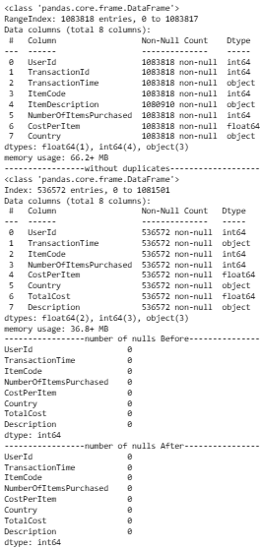
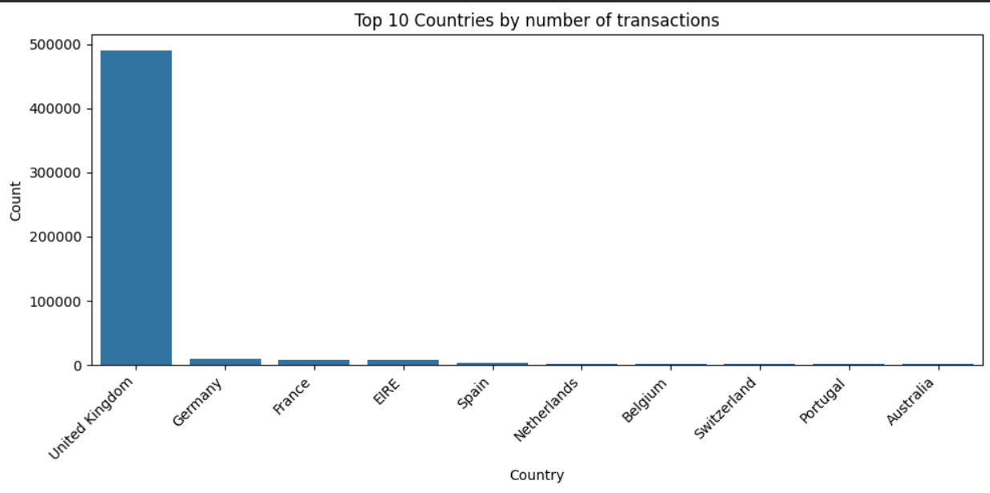
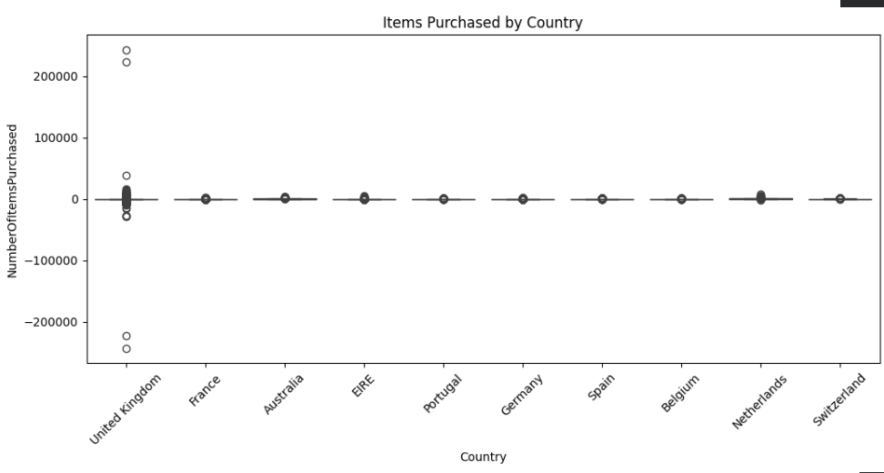
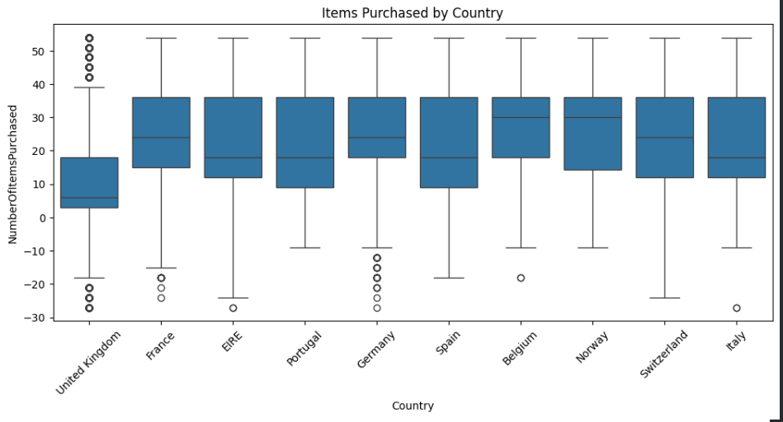
Data Preparation and Exploration
Removed duplicates & Null values & Fixed negative user ID.
Data Preprocessing for Description text (lower case ,no spaces,no symbols).
Feature engineered such as creating the category and total cost columns.
Removed Country section & Removed outliers such as following:
Before
After

Slide 7
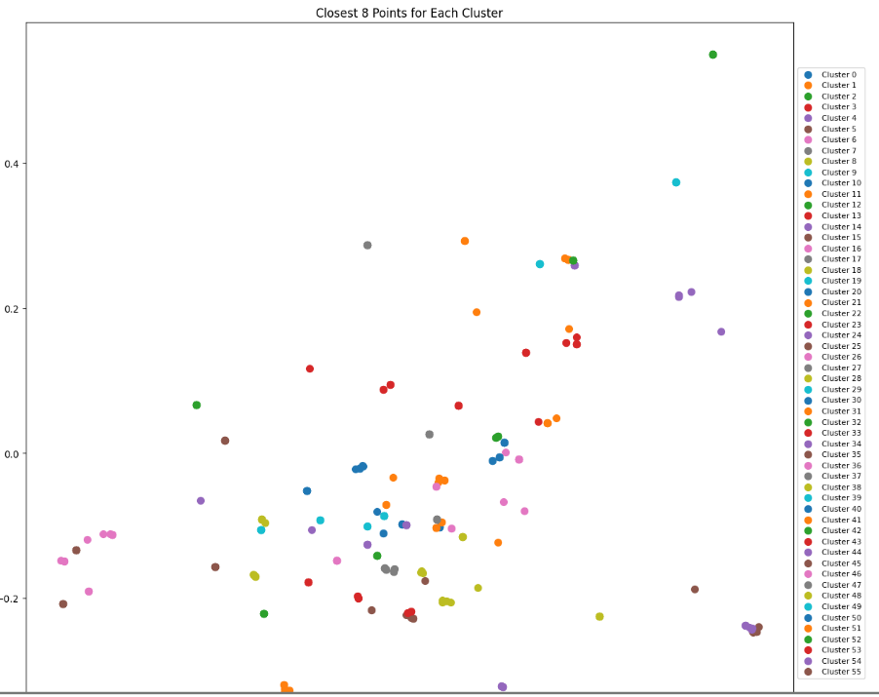
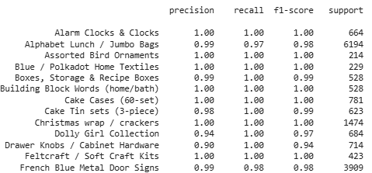

Model development and evaluation
Used NLP (TF-IDF) to get the important words of description and used TruncatedSVD to reduce it.
Unsupervised Learning (KMeans) and Elbow & Silhouette.
Used the 56 clusters with Creating the categories and used Supervised
Learning (Logistic Regression) with the normalized output.
Used confusion matrix for accuracy testing and got the following results:

Slide 8
Ethical Considerations and Limitations
Country feature is the only thing that can have bias since in this dataset
it was 90% UK so there should be more countries and balanced.
Even when i removed Outliers there are still many more.
Other columns needed such as name of the store to avoid relying
heavily on 1 feature more than the others.
Had to manually give category lists.

Slide 9
Conclusion and Future Work
To conclude this project goal is automatically classifying transactions into product categories using ML which ended on combining NLP method + Unsupervised + Supervised Hybrid Model and removed alot of blocks thats not needed which lead to heavily relying on Description column and without it the results drop to approx 28.8% but with it 98%.
For Future work:
    Deep learning for better text understanding.
    More Columns for better distribution of dependencies.
    Using time series in different countries to check for brands or seasons.

Slide 10

Refrences
https: //www.kaggle.com/datasets/vipin20/transaction-data
https://scikit-learn.org/stable/modules/generated/sklearn.metrics.confusion_matrix.html
https://www.geeksforgeeks.org/data-science/detect-and-remove-the-outliers-using-python/
https://docs.scipy.org/doc//scipy-1.16.2/reference/generated/scipy.sparse.hstack.html
https://scikit-learn.org/stable/modules/generated/sklearn.decomposition.TruncatedSVD.html

Slide 11
Thank you!

